Slide 1
Knock Yourself Out Secure Authentication with Short Re-Usable Passwords by Benjamin Guldenring, Volker Roth and Lars Ries
Presented by Eunyoung Cho
College of William and mary

Slide 2
Knock Yourself Out(KYO)
Client-side password generator mechanism
Mitigates the risks of simultaneous breaches of clients and multiple servers
Allows short passwords and password reuse
User friendly!
Protects against
Password manager loss
Multiple, simultaneous disclosure of server database
Computationally unbounded adversaries

Slide 3

Authentication - Acceptable Risk
What is an “acceptable (individual) risk”?
Look at ATM cards: 4 digits(0-9), three attempts allowed
Probability to guess PIN correctly is
Reasonable Baseline Security
To break the scheme, attacker needs to steal ATM card(first factor), and guess the correct PIN(second factor)

Slide 4
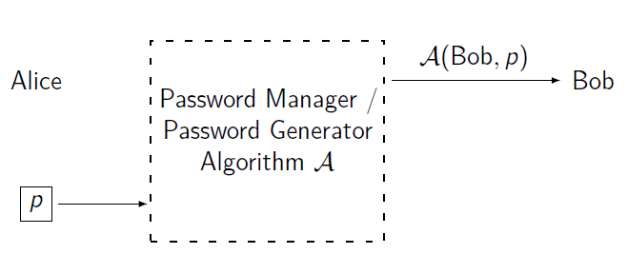
Authentication – Security and Safety
Alice uses her PW p and PW manager/generator to create a
secret A(Bob, p)
Security Threat : Adversary finds p or predicts A(Bob, p)
Safety Threat: Bob blocks Alice due to a wrong secret

Slide 5
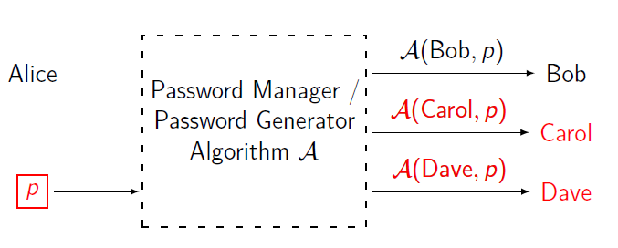
Authentication – Security Threat
Adversary might learn:
Up to N out of Bob, Carol or Dave: e.g. (virtual) server
Either PW manager: {stolen, lost} {computer, phone}
Or password p

Slide 6



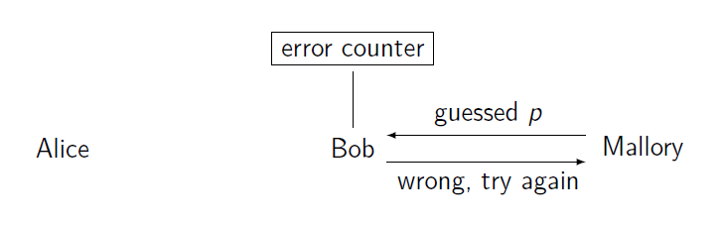
Authentication – Security Threats: Guessing
Mallory tries to guess Alice’s PW, repeatedly.
To limit Mallory’s tries, Bob blocks Alice’s account once a critical limit of failed attempts is reached (e.g. three)

Slide 7
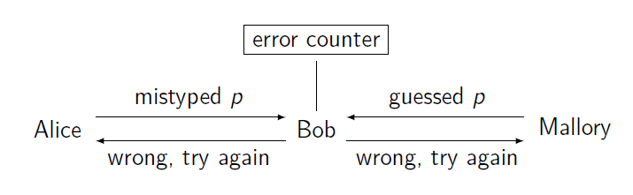
Authentication – Safety Threats: Input Error
Did Alice mistype her PW? Allowing Alice to retry is a
SAFETY MECHANISM(Check)
Does Mallory know the PW? Limiting Mallory’s tries is a
SECURITY MECHANISAM(Check)

Slide 8
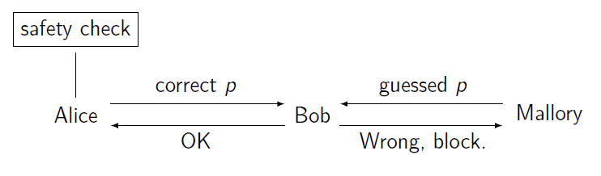
KYO Safety check – Input Errors
KYO catches input errors client-site
Bob blocks Alice’s account immediately, once Mallory show a wrong password

Slide 9
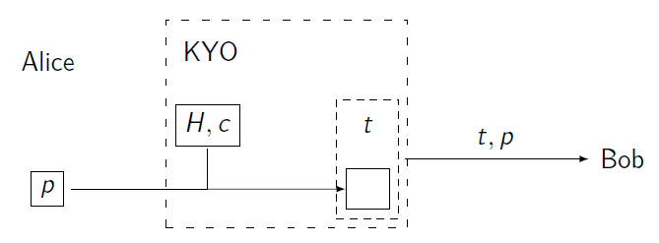
KYO Safety check
Generic safety check: For some H, is H(p)=c
Q1: How “good” is the safety check?
Q2: What does an adversary learn through H,c?
(t is Token)

Slide 10

Q1: How good is the safety check?
Measure the probability that safety checks fails, assuming a wrong password P was entered:
If H is a randomly selected function, the probability is the same for every distribution of P.

Slide 11
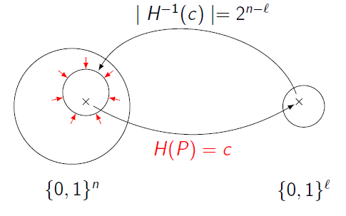

Q1: How good is the safety check?
For a randomly chosen function H: ${\text{\{0,1\}}}^{n}$ ${\text{\{0,1\}}}^{l}$,
|${\text{H}}^{−1}\left(C\right)$|is binomial distributed with average value ${\text{2}}^{n−l}$
For KYO safety: Make |${\text{H}}^{−1}\left(C\right)$| small enough

Slide 12
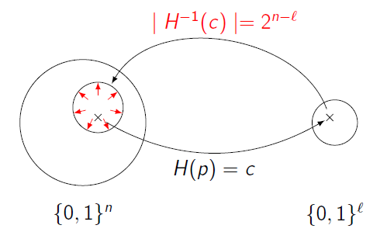

Q2: Adversary learning H,c
For a randomly chosen function H: ${\text{\{0,1\}}}^{n}$ ${\text{\{0,1\}}}^{l}$,
|${\text{H}}^{−1}\left(C\right)$|is binomial distributed with average value ${\text{2}}^{n−l}$
For KYO security: Make |${\text{H}}^{−1}\left(C\right)$| large enough

Slide 13
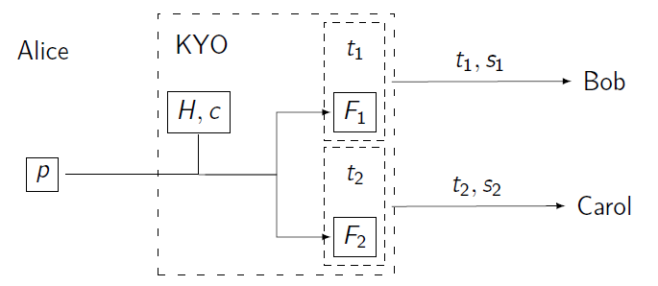
KYO – reusing passwords
Randomly choose functions F1 and F2
Secrets: s1 = F1(p) and s2 = F2(p)
What does an adversary learn about p and s1, given H, c, F1, F2, s2?

Slide 14
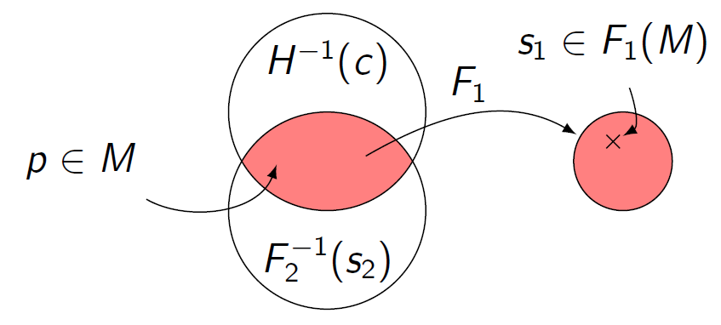

KYO – reusing passwords
Set M:= $H^{−1}\left(c\right)∩{F2}^{−1}\left(S2\right)$
For randomly selected H, F2: ${\text{\{0,1\}}}^{n}$ ${\text{\{0,1\}}}^{l} ,$the size of M is binomial distributed with average value $2^{n−2l}$
F1(m) is a bit smaller.

Slide 15


KYO – managing passwords
Given p, s, it is easy to select a F: ${\text{\{0,1\}}}^{n}$ ${\text{\{0,1\}}}^{l}$ with $n$ > $l$ randomly
Random sampling works well
Make use of that for flexible password management

Slide 16
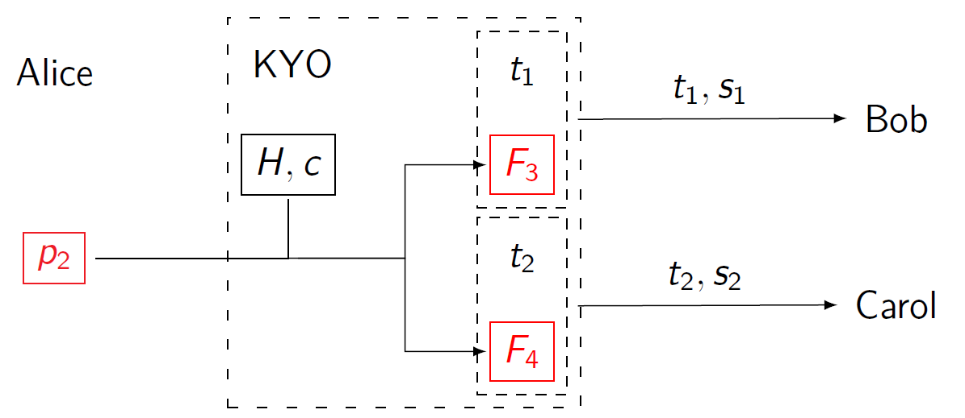
KYO – managing passwords
Renew Alice’s password p1:
Choose a new P2
Select F3, F4 with F3(p2) = s1(Bob), F4(p2) = s2(Carol)

Slide 17
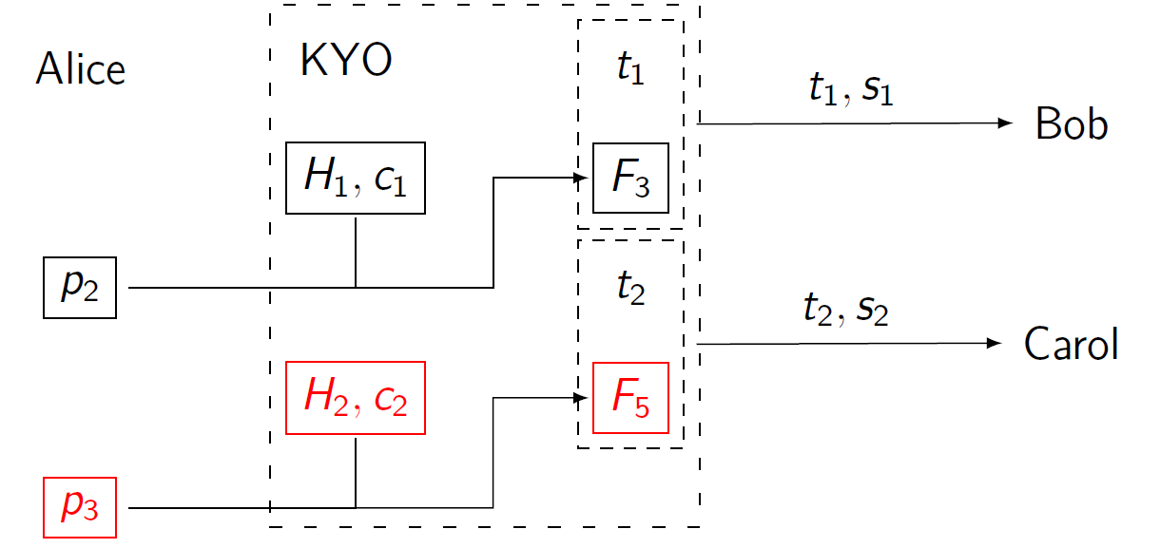
KYO – managing passwords
Different password for Carol:
Choose a new p3
Choose H2, set c2 := H(p3)
Select F5

Slide 18
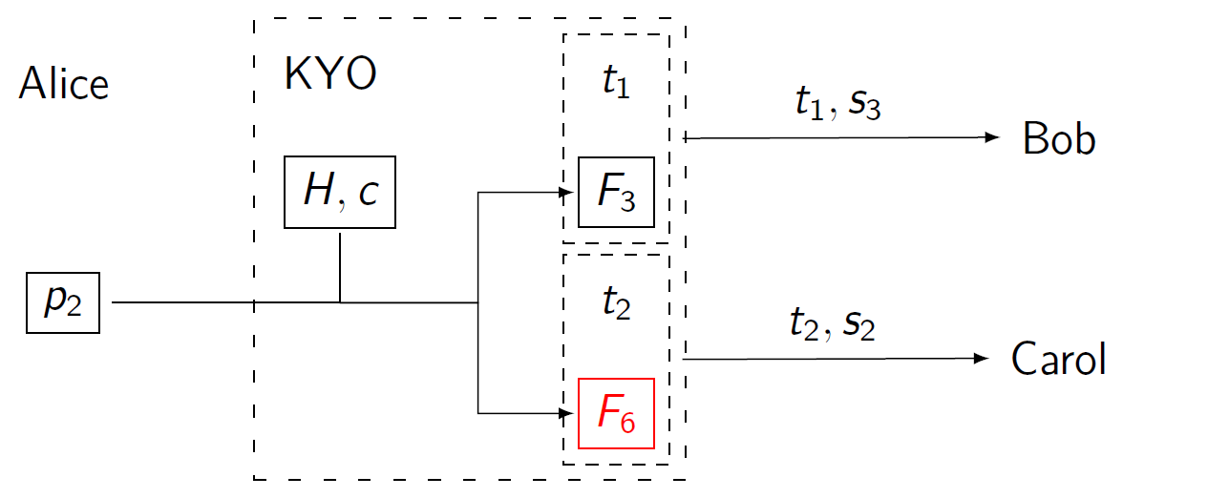
KYO – managing passwords
To merge passwords:
Dispose of H2, c2
Select F6

Slide 19
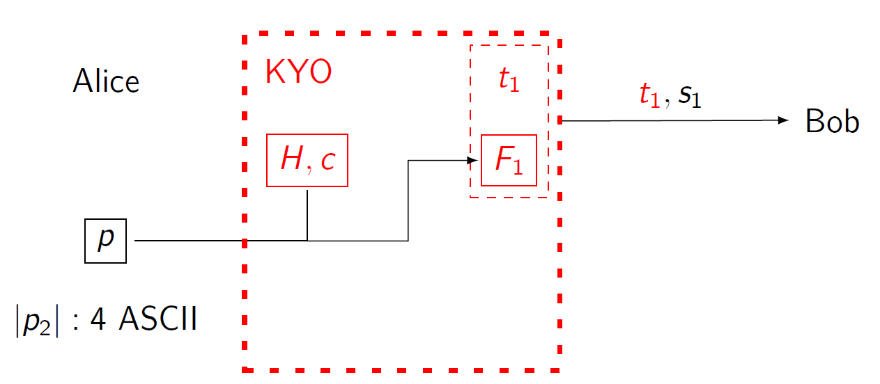

KYO: evaluation results – Theoretical results
Minimum password length for baseline risk $3{∙10}^{−4}$
4 ASCII (5 alphanumeric) chars withstand KYO loss

Slide 20
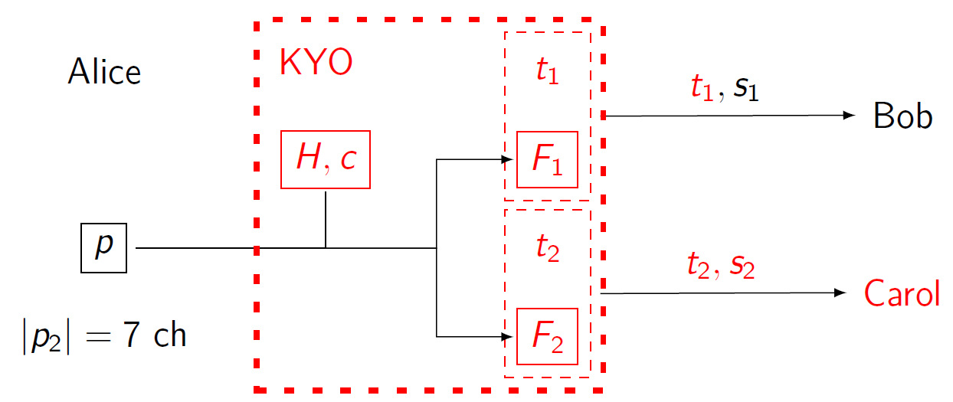
KYO: evaluation results – Theoretical results
What the average user could get:
Florencio found 6-7 alphanum. Chars average (~40bit)
7 alphanum. Char withstand KYO loss and 1 breach

Slide 21
KYO: evaluation results – Theoretical results
The insafety vs insecurity trade-off for password length n bit and disgest length
Longer digests improve safety, but yield more info on the password.

Slide 22
From theory to practice
In analysis: functions are chosen uniformly at random
But descriptions of H,F is too large to store in practice
Use decent hash functions neither collision-resistance nor pseudorandomness required
H, F output are taken from a random subset of all functions.

Slide 23
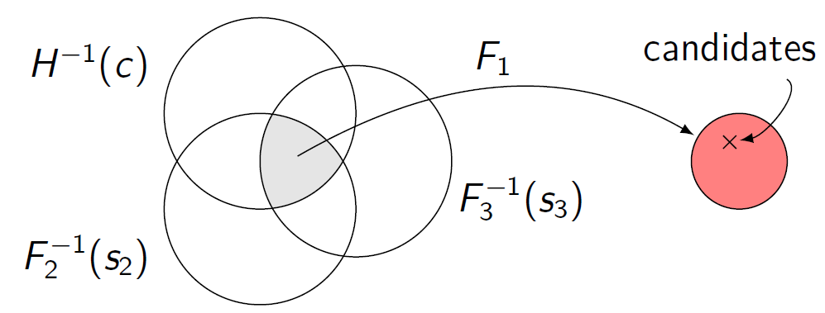

Implementation and preliminary results
2-Univ: F$σ\left(p\right)=\left(a\left(σ\right)∙p+b\left(σ\right)mod p\right)mod 2^{l}$
E.g. 30 bit password, three 6-bit secrets:
Avg candidate guessing probability: 0.016 $±0.011 \left(0.015 pred\right)$
Best candidate guessing probability: 0.019 $±0.015 \left(0.015 pred\right)$

Slide 24
Questions
1. KYO is a ( ) password generator mechanism that mitigate the risks of simultaneous breaches of clients and multiple servers.
2. What are two residual risks in KYO?
3. KYO does not rely on collision-resistant hash functions. Why?

